Slide 1

BIRT Reporting
Dima Ionut Daniel

Slide 2
Contents
What is BIRT?
Features
Basics
DataSource
DataSet
Binding Data
Conclusions
Bibliography

Slide 3

What is BIRT?
The Business Intelligence and Reporting Tools (BIRT) Project is an open source project.
It provides reporting and business intelligence capabilities for rich client and web applications, especially those based on Java and Java EE.
BIRT is a top-level software project within the Eclipse Foundation.

Slide 4
Features
BIRT is based on Eclipse IDE and Rich Client Platform (RCP) technology.
BIRT reports relies on 2 designer applications:
BIRT Report Designer
BIRT RCP Report Designer
The developer uses the designer to build a BIRT report design and preview it.

Slide 5
Features (cont.)
BIRT Report Designer consists of the following components:
Eclipse Software Development Kit (SDK): supports the development of plug-ins and extensions to the Eclipse.
Data Tools Platform (DTP): set of development tools used to develop plug-ins that access data sources and retrieve data
Eclipse Modeling Framework (EMF): supports the development of BIRT charts.
Graphical Editing Framework (GEF): Eclipse plug-in that the BIRT Report Designer user interface requires.
Eclipse Web Tools Platform (WTP): set of Eclipse plug-ins that support deploying the BIRT report viewer to an application server

Slide 6
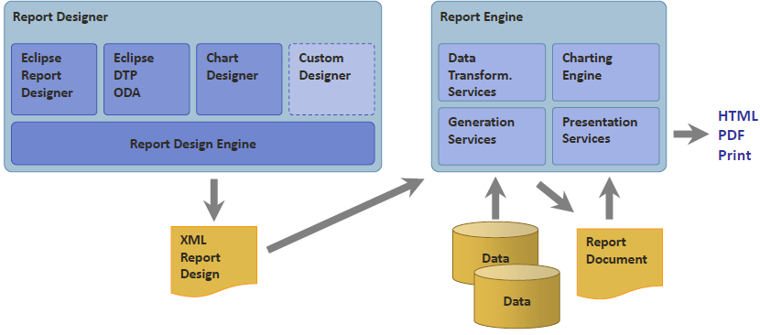
Architecture

Slide 7
Basics
Designing a report involves the following tasks:
Plan the report.
Start a new report design.
Specify the data to use.
Lay out the report.
Format the report.
Design a master page.
Preview and test the report.

Slide 8
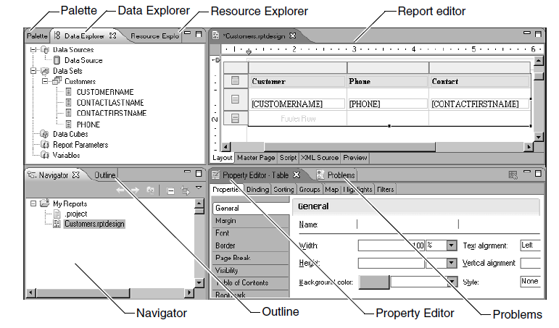
Basics (cont.)
The BIRT Report Designer views provide tools that you use to build and customize a BIRT report design, preview the report, and debug the report.

Slide 9
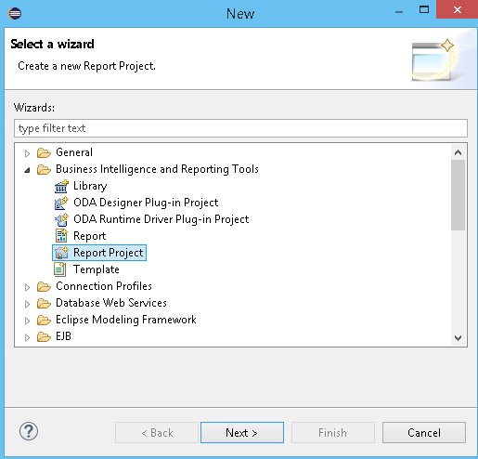
Basics (cont.)
A BIRT report is a structured document that displays data from an external system(database or application).
Using BIRT Report Designer we can create operational reports(billing materials, a purchase order, or an invoice).

Slide 10
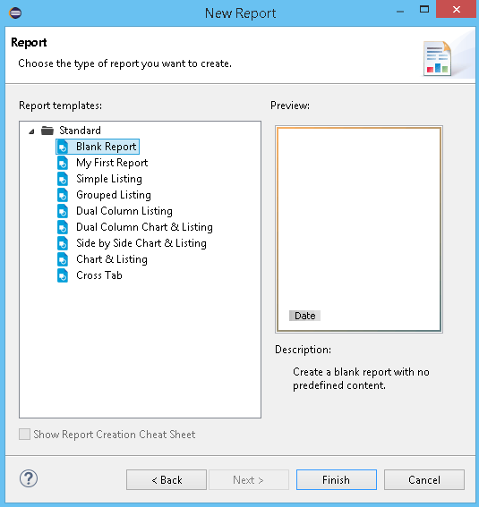
Basics (cont.)
We need to create a new Report Project and after that we can start creating reports.
When creating reports we can start working from a blank report or a template.

Slide 11
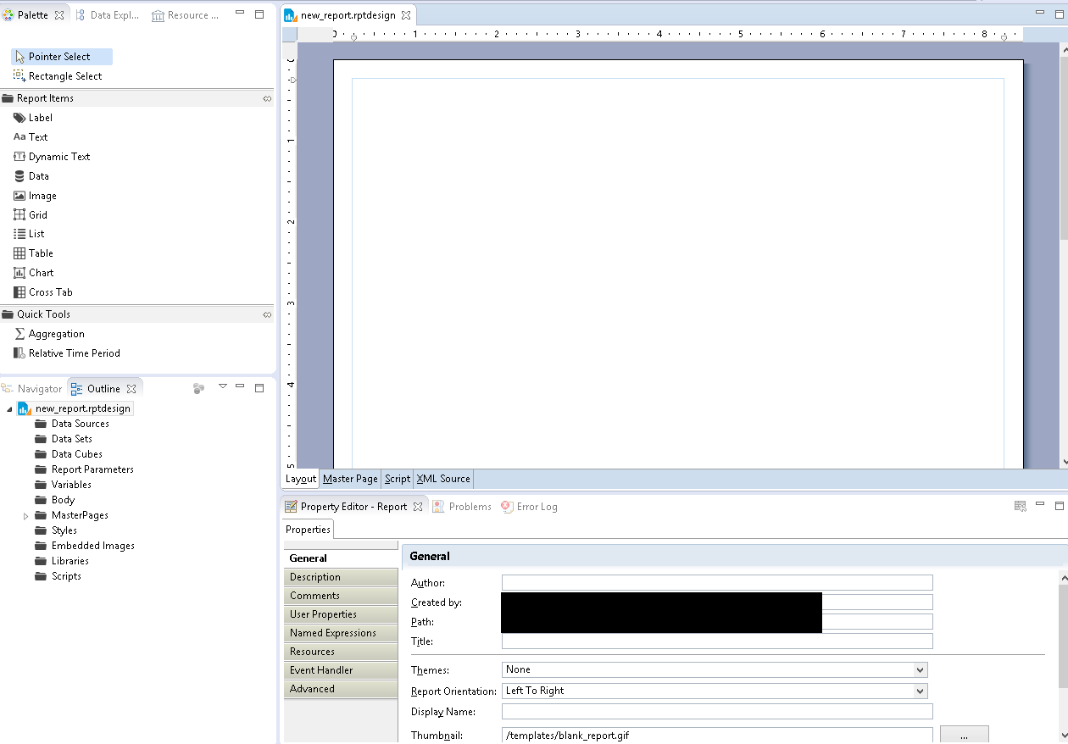
Basics (cont.)

Slide 12
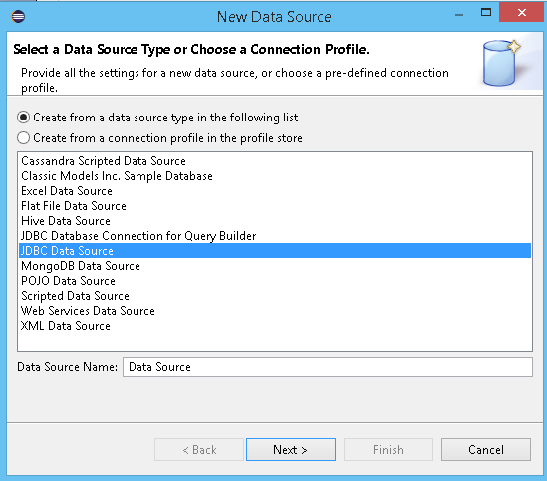
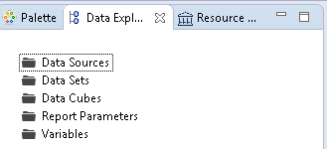
Basics (cont.)
We need to define data sources from where to extract data.

Slide 13
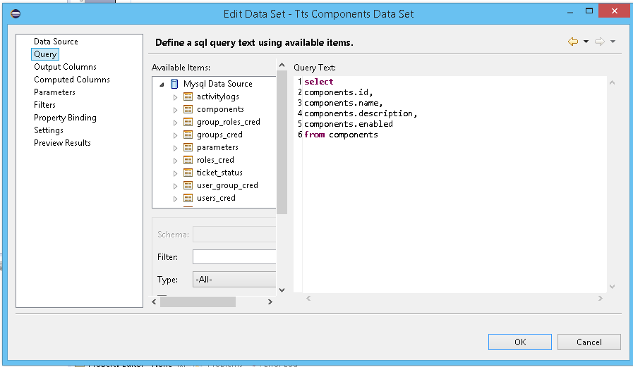
Basics (cont.)
A data set identifies the data to retrieve from the data source.
If your report connects to a JDBC data source, we use a SQL SELECT statement to specify the data to retrieve.

Slide 14
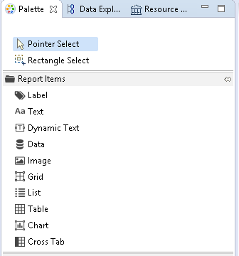
Basics (cont.)
From the Palette Window we can drag & drop components in order to build the report.

Slide 15
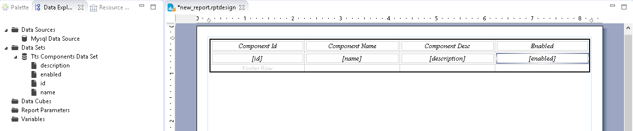
Basics (cont.)
We can drag and drop a table component and bind it to the Data Set component defined.

Slide 16
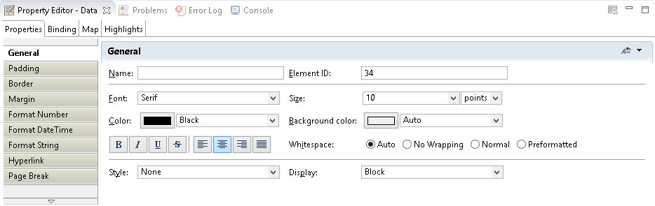
Basics (cont.)
Using the Property Editor we can edit various properties of the elements used in the reports.

Slide 17
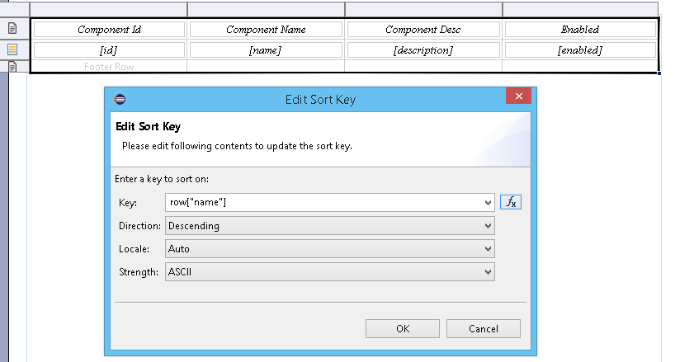
Basics (cont.)
We can perform sorting using “Sorting ” TAB from Table Properties Editor.

Slide 18
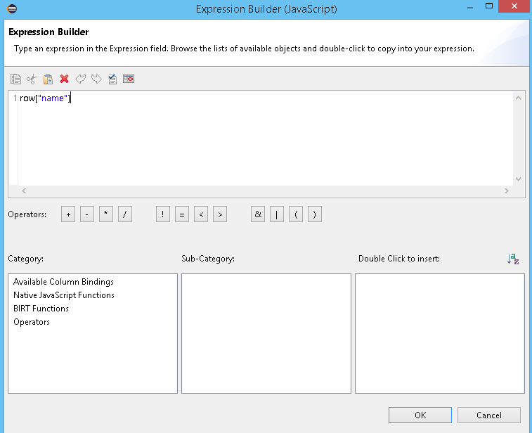
Basics (cont.)
We can build expressions using the Builder.

Slide 19
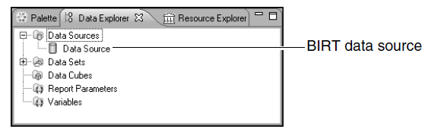
DataSource
BIRT Report Designer provides wizards to set up access to the
following types of data sources:
JDBC data sources
Text files
XML documents
Web services

Slide 20
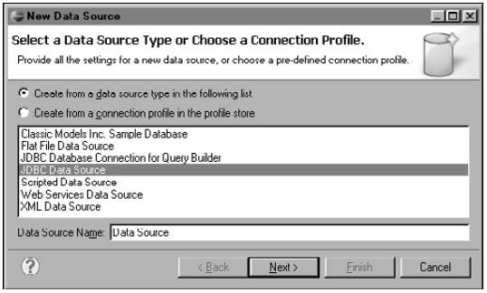
DataSource(cont.)
When creating a JDBC data source in BIRT, we select the driver class and provide a URL to connect to the database.

Slide 21
DataSet
A data set is an object that defines all the data that is available to a report.
To create a data set, we must have an existing BIRT data source.
We can create multiple data sets that use a single data source.

Slide 22
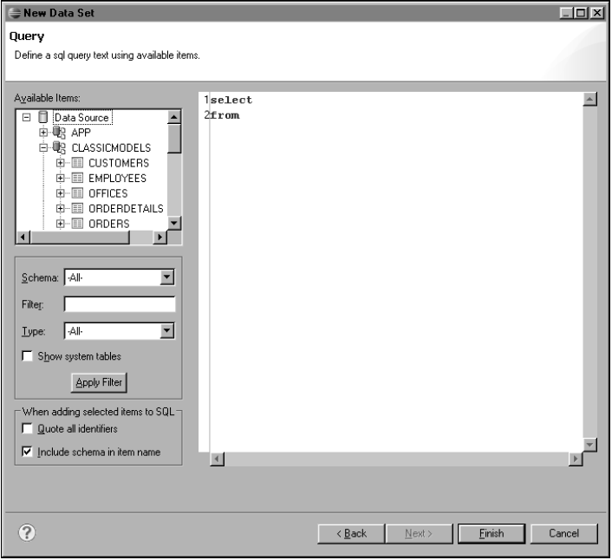
DataSet(cont.)

Slide 23
Binding Data
The data sets that we create provide the data we want to use in a report.
Before we can use or display this data in a report, we must first create the necessary data bindings.
Data binding defines an expression that specifies what data to display.

Slide 24
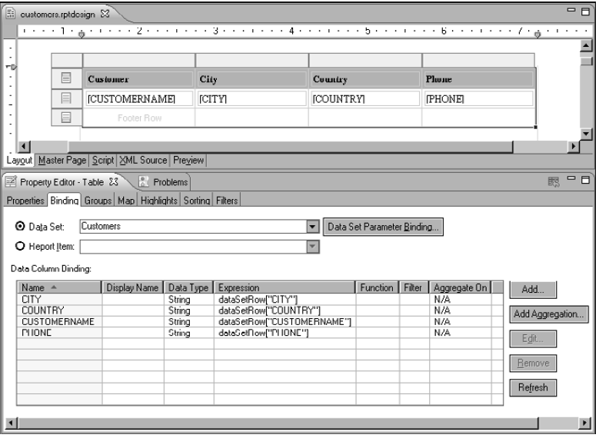
Binding Data(cont.)

Slide 25
Conclusions
Easy to use
IDE based on Eclipse.

Slide 26

Bibliography
https://en.wikipedia.org/wiki/BIRT_Project
BIRT A Field Guide, 3rd Edition

